Slide 1
Driver Drowsiness Detection System Final year Project Presentation
Presented by :- Pranjali Hiwale.
Anand Kalsait.
Kishori Choukade.
Aishwarya Puri.
Guided by :- Prof. Dhiraj Shirbhate

Slide 2
Abstract
Drowsiness of drivers is amongst the significant causes of road accidents. Every year, it increases the amounts of deaths and fatalities injuries globally.
In this project, a module for Advanced Driver Assistance System (ADAS) is presented to reduce the number of accidents due to drivers’ fatigue and hence increase the transportation safety.
This system deals with automatic driver drowsiness detection based on visual information .
We have write to locate, track, and analyse both the drivers face and eyes to measure PERCLOS (percentage of eye closure), a scientifically supported measure of drowsiness associated with slow eye closure

Slide 3
INTRODUCTION
Drowsiness detection is a safety technology that can prevent accidents that are caused by drivers who fell asleep while driving. This system will alert the driver when drowsiness is detected. Through its driver Availability Detection System, sensors will scan the face to ensure that the eyes are open and the driver is alert before the cars turns over the steering wheel. If drowsiness is detected, the driver is alerted to the nearest rest stop.
In this project, drowsiness detection application will be designed and implemented using a RTSP enabled Camera. To implement this, we will be using OpenCV in Python

Slide 4
OBJECTIVE
Driver drowsiness detection is a car safety technology which helps to save the life of the driver by preventing accidents when the driver is getting drowsy.
The main objective is to first design a system to detect driver’s drowsiness by continuously monitoring retina and eyelid of the eye.
The system should work in spite of driver wearing spectacles and in various lighting conditions
To alert the driver on the detection of drowsiness by using buzzer or alarm and sending an SOS notification with the current location of the Driver.

Slide 5





Software Requirements Specification
Visual Studio Code
PyQT Designer
SQLite Studio
CMake
Arduino IDE
Standard Firmata, Micro RTSP
Python libraries
OpenCV, Dlib, Imutils, Pyfirmata, Sys, Sqlite3, PyQt5, Smtplib, Email, PyInstaller

Slide 6
HARDWARE Requirements Specification
Laptop (Raspberry PI for small form factor)
Arduino Uno
ESP32-Cam
Buzzer and Various Jumper Wires
Breadboard Power Supply Board and 9V DC Power supply
USB to SERIAL Power Cable

Slide 7
limitations
Wi-fi Coverage
Climatic Conditions
Moderate Accuracy
Hardware Availability

Slide 8
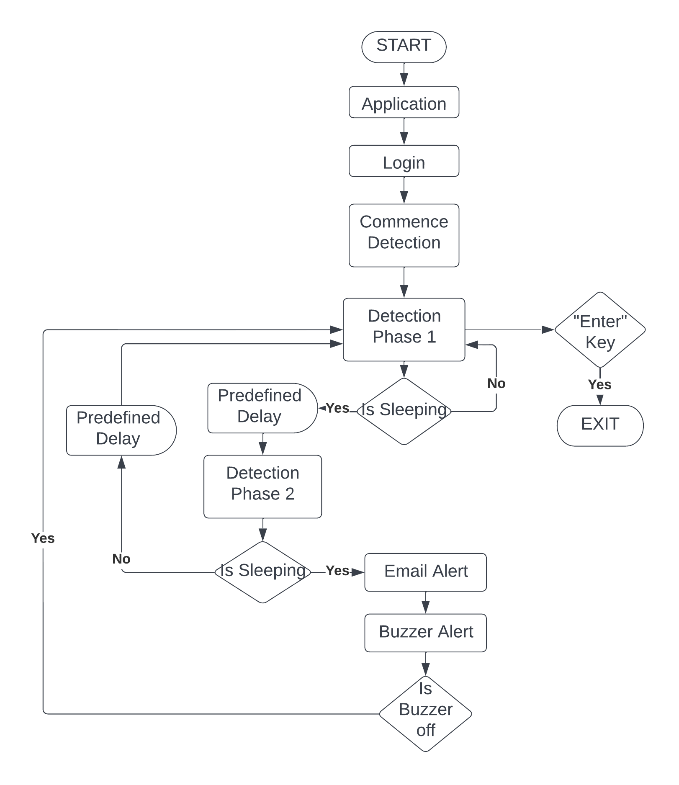
System design

Slide 9
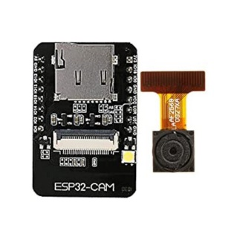
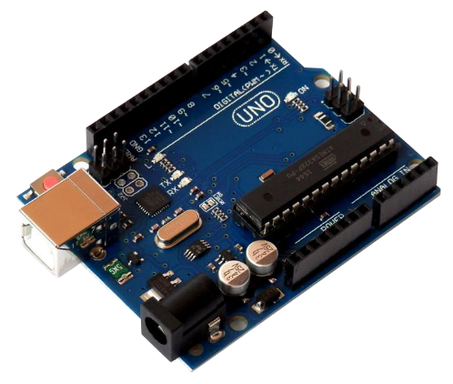
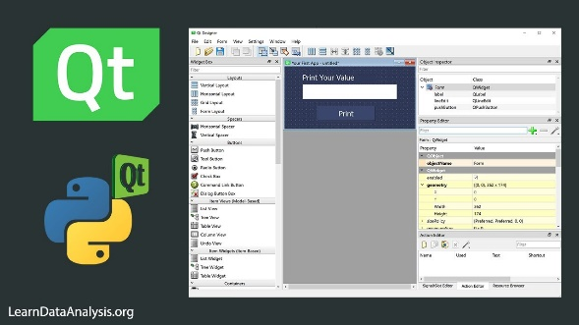
Implementation
Enabling RTSP on ESP32-Cam
with Micro-RTSP sketch
Uploading the Arduino UNO
with Standard Firmata sketch
Programming the detection system
in python using various libraries
Developing the GUI for the system
using PyQt Designer
Testing and Debugging

Slide 10
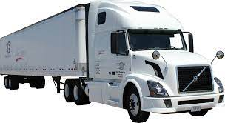
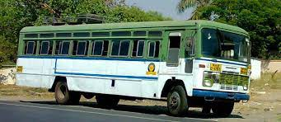
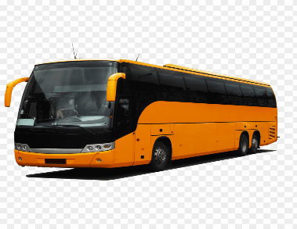
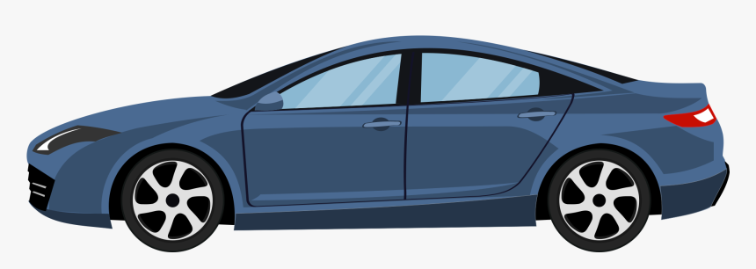
Application
Transportation vehicles
Public transport
Private vehicles
Railways
To keep an eye on security guards

Slide 11
Advantages
Accident victim’s death can be prevented
Easy to implement
Small Form Factor with separately working components
Any ONVIF and RTSP supported camera can be used
Practically applicable and User friendly Interface
Low cost of equipment

Slide 12
SCOPE FOR FUTURE
The future works may focus on the utilization of outer factors such as vehicle states, sleeping hours, weather conditions, mechanical data, etc. for fatigue measurement.
Driver drowsiness pose a major threat to highway safety, and the problem is particularly severe for commercial motor vehicle operators.
Twenty-four hour operations, high annual mileage, exposure to challenging environmental conditions, and demanding work schedules all contribute to this serious safety issue.
Monitoring the driver’s state of drowsiness and vigilance and providing feedback on their condition so that they can take appropriate action is one crucial step in a series of preventive measures necessary to address this problem.
Currently there is not adjustment in zoom or direction of the camera during operation. Future work may be to automatically zoom in on the eyes once they are localized.

Slide 13
Conclusion
The drowsiness detection and correction system developed is capable of detecting drowsiness in a rapid manner.
The system which can differentiate normal eye blink and drowsiness which can prevent the driver from entering the state of sleepiness while driving.
The system works well even in case of drivers wearing spectacles and under low light conditions also.
During the monitoring, the system is able to decide if the eyes are opened or closed. When the eyes have been closed for about two seconds, the alarm beeps to alert the driver and the speed of the vehicle is reduced (for future reference).
By doing this many accidents will reduced and provides safe life to the driver and vehicle safety.
A system for driver safety and car security is presented only in the luxurious costly cars. Using drowsiness detection system, driver safety can be implemented in normal cars also.

Slide 14
THANK YOU!

